Slide 1
KOKO Product Tracking and Versioning

Slide 2
Objective
Objective of this document is to point out the options we have to track the Part changes in our KOKO Products.
In Current processing we have the new magnetic Hatches introduced to replace the old hatches, to resolve the issues of Hatch popping out from the Stove.
In future also some parts can be introduced to improve the KOKO Products [Cooker and Canisters]

Slide 3
Implementation Approach

Slide 4
Implementation Approach
In KOKO ERP we have following masters, we need to manage to track the items with new Hatch.
Product BOM [In KNI ERP]
Product Tracker [In KNI ERP]
Product Tracker [In KNK ERP]
Product Master [In KNK ERP]
Product Master and Mapping B/W [KNI and KNK]
Note: Currently we have 6071 Kit in India with Magnetic Hatches which will be shipped to Kenya in the month of December.

Slide 5


Short Term Approach - Option 1
To facilitate system to capture the record of the Products coming in with Magnetic Hatches we can add a process in the system as described below:
For new Incoming products:
Adding a flag “Magnetic Hatch” in the Product tracker to segregate them from the Old Cookers.
Updating the Product tracker for existing stock and set the flag as true.
Setting / Configuration
Set Magnetic Hatch check In Product Tracker
Off On
Process GRN in KNK Erp
Cooker Product Tracker
With Magnetic Hatch

Slide 6
Short Term Approach - Option 1
For Existing stock:
For existing stock in the warehouse, if the business have decided that all the Cooker will be going out with the new Magnetic Hatches installed we can update the Product tracker [For Cooker] for all the Cookers in the Warehouse Stock Locations, through Database query [Really Quick] or through the script [Will take time in coding and deployment]
As updation of the products in warehouse is a one time task, we should take shortest way of updation through Backend database query.
Another Option is to create a process where we can update the product Tracker at the time of Loading operation. This process will take time in development and deployment. [Need to check if this effort is worth for only one time use].

Slide 7
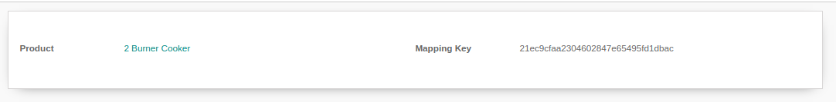
Short Term Approach - Option 2
For new Incoming Products:
In option two as we can create the new Product Master for cooker with magnetic hatch [e.g. 2 burner Cooker V2] and configure the same in Product Structure and Product Mapping Key.
In this process the new incoming cooker will be 2 burner cooker V2. [No development required]
For Existing Products in the warehouse:
We can update the Product tracker for the existing products and change the product for the cooker [“2 Burner Cooker” to “2 burner cooker V2”]

Slide 8
Long Term Approach - Option 1
To automate change management in the BOM [e.g. Magnetic Hatch or any other component] we can use the change management concept in the system.
We can track the version of the BOM and also track the items replaced, added or removed for the BOM
The Product Tracker in KNI is created through the Manufacturing process itself so we can also add the Product BOM Version in the Product to specify what items are used to create the BOM.
The Information can be synced to the KNK system while creating the product tracker of the new products.
This process will be true for all the changes done in the products and tracking would be easy for all the future updates as well.

Slide 9
Long Term Approach - Option 1
KNI ERP
KNK ERP
Change in the BOM Of Cooker:
Further Operations / Tracking can be managed Based on the BOM Version. Required Change Log can be Pulled from KNI system
BOM 1
Without Magnet Hatch
BOM 2
With Magnet Hatch
In KNI Product Tracker, we will record the BOM version, On creation through Manufacturing process
In KNK Product Tracker, we will receive all the information In KNK Product tracker.
Coker Serial : 2000xxxxx
Production BOM : BOM 2
Coker Serial : 2000xxxxx
Production BOM : BOM 2

Slide 10
New Approach and Mockups

Slide 11
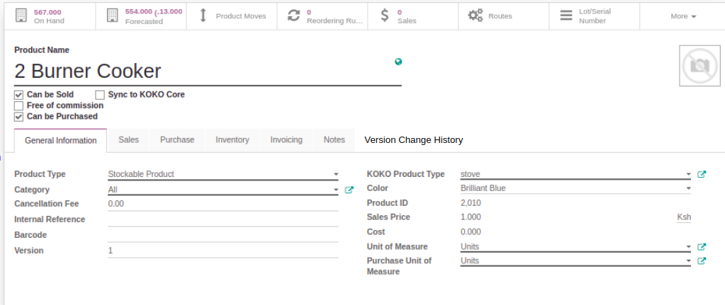
New Approach to manage the Versioning in KNK
In KNK as we want to manage the versioning without changing lot in the current process. For that we can have the following process:
Manage the Versioning in the Product Master
As shown in the below screen we can make a record in the KNK product Master. Including the changes we have introduced in the product, in the version change history tab.

Slide 12
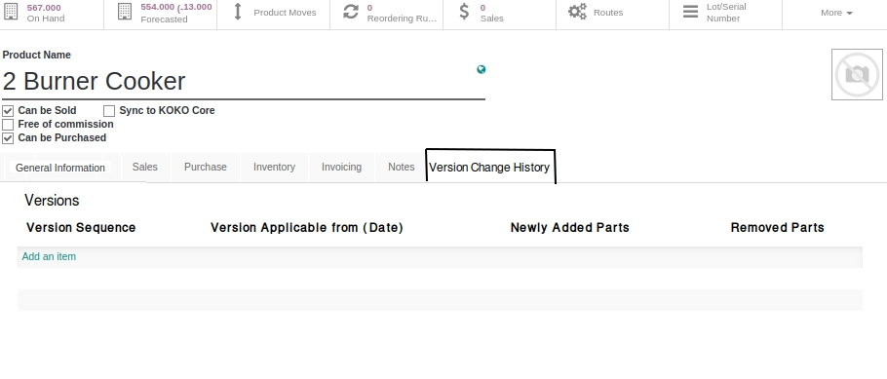
New Approach to manage the Versioning in KNK
In Version change history we can have following information included:
Version Sequence (Auto Generate)
Version Applicable on date
Added Parts
Removed Parts.

Slide 13
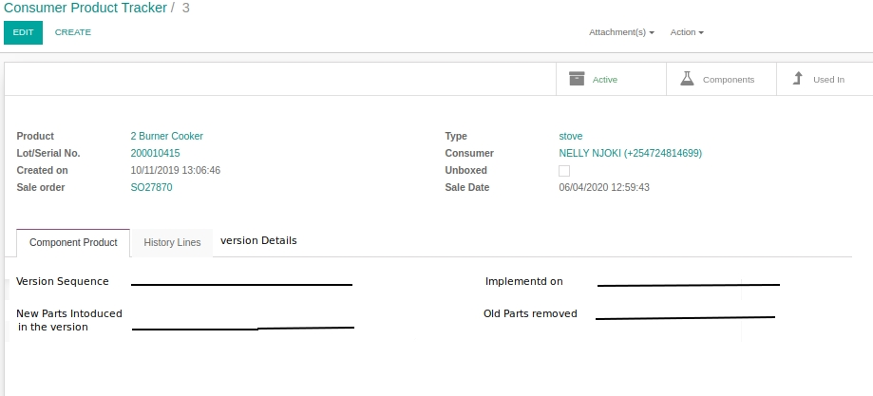
New Approach to manage the Versioning in KNK
Now at the time of GRN we can record the newest version details in the Consumer Product tracker as shown below: (We can also choose if we need to show less information)

Slide 14
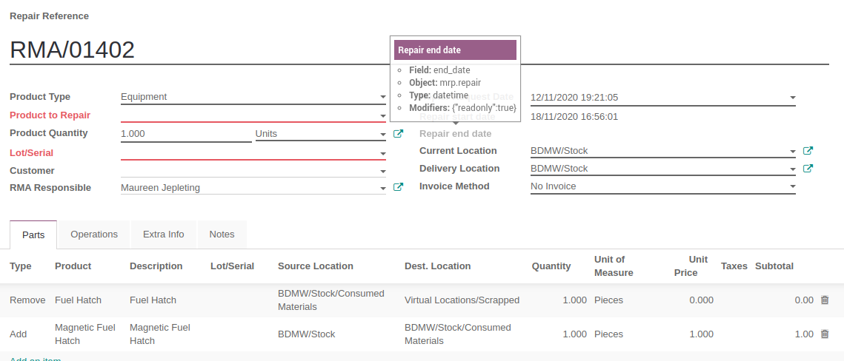
New Approach to manage the Versioning in KNK
Now in case of repairs currently we don’t have the option to change the version. But a better option can be if we maintain the history of the replaced items in the repair Orders:

Slide 15
New Approach to manage the Versioning in KNK
Once the repair is done we add the information in the “History Line” in product tacker that new product is added.

Slide 16
Thank You !!

